Slide 1
Chapter 15
The cost of capital
Slides by Prof C Rootman,
Dr S Watson, Ms E Kobese
& Ms N Maliwa

Slide 2
Learning outcomes: Chapter 15
apply an accurately calculate the cost of long-term debt
accurately calculate the cost of preference shares
accurately calculate the cost of ordinary shares
accurately calculate the weighted average cost of capital (WACC)
use cost of capital for the purpose of investment decisions.

Slide 3
Introduction
Wealth is created (remember Ch 1 SHW) by embarking on investment opportunities that realise returns that are at least equal to (preferably higher than) those required by investors
Remember Ch 13: Investment can only add value if its return > the required rate of return (RRR)
RRR same as discount rate and k or r
How do we know the discount rate to use…? (in previous chapters it was given; in THIS chapter it is all about CALCULATING it! ☺)
If investors are the shareholders who provide a firm with funding, the rate of return required by shareholders is that firm’s cost of capital… (the same applies to debtholders…)
Two sides of the coin

Slide 4
Introduction (cont.)
Shareholders want a return…dividend yield and capital gains
Debtholders want a return…interest and the capital paid at maturity…
Those returns they require…are costs to the firm…

Slide 5
Introduction (cont.)
Ch 6: explored relationship between the expected return on an investment and its systematic risk from an investor’s (shareholder’s) viewpoint
The return an investor receives on a security is the cost of that security to the company that issued it…
Two sides of the same coin…
Ch 15: how returns and investments appear from the viewpoint of the companies that issue them…
Return the investors require = cost for the firm
Required return = appropriate discount rate = cost of capital

Slide 6
Introduction (cont.)
Ch 6: Discussion of risk and return…the correct discount rate depends on the riskiness of the project
From Ch 13 we know NPV > 0 only if the new project’s internal rate of return (IRR) exceeds what the financial markets offer on investments of similar risks
minimum required rate of return is thus = cost of capital associated with the project
Thus, to make the right decision, examine what the capital markets offer and use the information to arrive at an estimate of the project’s cost of capital; as in Ch 15

Slide 7
Introduction (cont.)
Capital structure of a firm dictates the amount and sources of finance for the funding (can raise capital in variety of forms/components)
Each type of capital source has its own component cost
By weighting the component costs of each source of funding by its proportion in the capital structure, we may obtain the cost of capital to the firm ∴ the RRR or discount rate to use
We calculate the after-tax cost of funds to the firm
Vital when calculating cost of debt because interest paid on debt is an expense that enables a firm to pay less tax as a result of lower taxable profit)
Known as the weighted average cost of capital (WACC)

Slide 8
Introduction (cont.)
WACC
Need weight or % of each of the different capital sources
Need costs of each of the different capital sources
= Sum of [weight of EACH capital source x cost of EACH capital source]
OR
= [weight of debt x after-tax cost of debt] + [weight of preference shares x cost of preference shares] + [weight of ordinary shares x cost of ordinary shares]
OR
= [(D/V) x k_{i}] + [(P/V) x k_{p}] + [(E/V) x k_{n}]

Slide 9
Examples of firms using WACC
Source:
https://picknpayinvestor.co.za/pdf/annual-report/2025/integrated-annual-report-2025-singles.pdf;
https://www.shopriteholdings.co.za/shareholders-investors.html#report

Slide 10
Financing weights
Mixture of debt and equity: a firm’s capital structure
Managerial variable
Ch 15: assume firm has a fixed debt/equity (D/E) ratio that it maintains (target capital structure)
We’ll return to this topic in Ch 16
Remember: D/E ratio calculations in Ch 4…
Debt/Equity ratio = TD / TE
Firm’s overall cost of capital will reflect the required return on the firm’s assets as a whole
Firm uses both debt and equity – overall cost of capital will be a mixture of the returns needed
to compensate both its lenders and its shareholders
Cost of capital will reflect both its cost of debt capital and its cost of equity (preference and ordinary shares separately) capital

Slide 11
Financing weights (cont.)
Same info as in TB, just in a different sequence
WACC = [(D/V) x k_{i}] + [(P/V) x k_{p}] + [(E/V) x k_{n}]
First, we need to find the capital structure weights
The % of each capital source
MV_{d} = the market value of the firm’s debt capital (D)
MV_{d} = number of bonds in issue x market price (PV) of a single bond

Slide 12
Financing weights (cont.)
MV_{p} = the market value of the firm’s equity capital (preference shares) (P)
MV_{p} = number of issued shares x current price per share (P₀)
MV_{s} or MV_{n}= the market value of the firm’s equity capital (ordinary shares) (E)
MV_{s} = number of issued shares x current price per share (P₀)
Note: Remember, these 3 weights (or even 2 of them if a firm uses debt and ordinary share capital only) could be GIVEN

Slide 13
Financing weights (cont.)
Find the combined (total) market value of all the equity (preference and ordinary shares) and debt (V)
Then calculate the % of the total capital represented by the different capital sources (both equity sources and debt):
D/V to get debt %; E/V to get ordinary shares %; P/V to get preference shares %
D/V + P/V + E/V = 100%
The %’s are called the capital structure weights
Note: if D/V = 30% and P/V = 40%, then E/V must be 30%, etc.
Note: Let’s say a firm has no preference share capital and D/V = 60%, then E/V must be 40%, etc.

Slide 14
Component costs
WACC = [(D/V) x k_{i}] + [(P/V) x k_{p}] + [(E/V) x k_{n}]
We now know the weights of the capital sources (or capital structure)
The % of each capital source
Now we need to calculate the different capital sources’ costs
Let’s start with the cost of ordinary shares (most “difficult” one)
[Thereafter we can combine the info to calculate the WACC]

Slide 15
Component costs: Ordinary shares
Cost of equity
We combine cost of ordinary shares, cost of retained earnings and cost of newly issued shares. We consider flotation costs later (which is admin/issue costs applicable when a firm issues new ordinary shares. Therefore, you can use k_{s} or k_{n} to denote cost of ordinary shares
What is the firm’s overall cost of equity (k_{s} or k_{n})?
Difficult to answer…no way of directly observing the return that the firm’s equity investors (shareholders) require on their investment
Two approaches to estimate it:
security market line (SML) or capital asset pricing model (CAPM) as in Ch 6
dividend growth model as in Ch 8

Slide 16
Component costs: Ordinary shares (cont.)
Security market line (SML) (quick recap)
Required / expected return on a risky investment depends on:
Risk-free rate R_{f}
Market risk premium k_{m} – R_{f}
Systematic risk of the asset β
Using the SML:
k_{s} = R_{f} + β(k_{m} – R_{f})

Slide 17
Component costs: Ordinary shares (cont.)
Example using SML
Estimate a Platinum company’s cost of equity, k_{s}, using the following information:
Market risk premium (the returns earned on average in the market above the risk-free rate, based on large ordinary shares) = 8.5%
…inside the brackets…
Assume SA Treasury bills paying 8.6%
Platinum company’s Beta (β) = 1.63

Slide 18
Component costs: Ordinary shares (cont.)
k_{s} = R_{f} + β(k_{m} – R_{f})
= 8.6 + 1.63 (8.5)
= 22.46%

Slide 19
Example: A real company’s share price
Current share price = 144.93; Current Beta = 1.8
The global demand for mining minerals…
Can we deduce the share price’s dependency on the economy by looking at its beta?
Its β > 1 which means it reacts more severely to overall market fluctuations, if the economy grows, they prosper more than average, but when it slows down, they suffer more than average (fewer platinum based products are being sold). If just over 1: only reacts slightly more than the average share in the market.
Think about how the last few years influenced companies operating in the mining industry…..

Slide 20
Component costs: Ordinary shares (cont.)
The dividend growth model (quick recap)
Jumbo Burgers Ltd, a large public company, paid a dividend of R4 per share last year. The share price is currently R60. You estimate that the dividend will grow steadily at 6% per year into the indefinite future. What is the cost of equity (ordinary share) capital for Jumbo?
[You are required to calculate the return.
k_{s} or k_{n} is the return that the shareholders require, thus it can be interpreted as the cost of equity (ordinary share) capital for the firm]

Slide 21
Component costs: Ordinary shares (cont.)
Use the dividend growth model
k_{s} = (D₁ / P₀) + g
D₁ = D₀(1 + g)
= 4(1.06)
= R4.24
k_{s} = (D₁ / P₀) + g
= (4.24 / 60) + 0.06
= 13.07%
(Remember to show your answer as a %)

Slide 22
Component costs: Ordinary shares (cont.)
BUT if we have flotation (issue/admin) costs then be account for that:
k_{n} = (D₁ / N_{s}) + g
We will look at flotation costs in later examples

Slide 23
Component costs: Preference shares
In addition to the cost of equity (which specifically consider ordinary shares), a firm can also issue preference shares as discussed in Ch 8
Therefore, we need to consider the cost of preference shares (k_{p})
Preference shares have a fixed dividend paid every period forever…perpetuity; remember Ch 8
Cost of preference shares = dividend yield on the preference shares
Recall: D₀ = D₁ = D₂ = D_{n}
k_{p} = D / P₀ as in Ch 8

Slide 24
Component costs: Preference shares (cont.)
Example
A company’s R100 preference shares are trading at par and are paying R10 per share as a preference dividend. What is the company’s cost of preference shares, k_{p}?
k_{p} = D / P₀
= 10 / 100
= 10%
BUT if we have flotation (issue/admin) costs then be account for that:
k_{p} = D / N_{p}
We will look at flotation costs in later examples

Slide 25
Component costs: Debt capital
Cost of debt is the return that a firm’s lenders demand (require) on new borrowing
Unlike a firm’s cost of equity (k_{s} or k_{n}) which is difficult to observe and needs to be calculated, its cost of debt, k_{i}, can normally be observed
Cost of debt is the yield or rate of return the firm must generate on new borrowing (quoted interest rate)

Slide 26
Component costs: Debt capital (cont.)
k_{d} is a firm’s cost of debt
However, we need to use the after-tax cost of debt!
(reason for this explain on an intro slide)
After-tax cost of debt = k_{d} x (1 – t), where t is the firm’s tax rate

Slide 27
Component costs: Debt capital (cont.)
Calculate Jumbo’s cost of debt, using the following information:
The yield or rate of return the firm must generate on new borrowing = 9%
The firm’s tax rate = 30%
After-tax cost of debt (k_{i}) = k_{d} x (1 – t)
= 9 x (1 – 0.3)
= 6.3%

Slide 28
WACC
We now have the:
Capital structure weights
Cost of the main sources of capital (equity capital and debt capital)
To calculate the firm’s overall cost of capital (WACC): multiply the capital structure weights by the associated costs and add them up…

Slide 29
WACC (cont.)
WACC = [(D/V) x k_{i}] + [(P/V) x k_{p}] + [(E/V) x k_{n}]
WACC = overall return the firm must earn on its existing assets to maintain the value of its shares and its debt
WACC = required return on any new investments by the firm that have the same risk levels as existing operations
If evaluating the CFs from a proposed projects, this is the discount rate (k) we would use

Slide 30
WACC (cont.)
WACC vs RRR
Examples of when a firm’s WACC can be used as the discount rate:
Pizza business thinking of opening a new location
Retailer thinking of a new store/outlet
Manufacturer thinking of expanding production capacity
Consumer products company thinking of expanding its markets
However, when the CFs of the proposed project have risks different from those of the overall firm….problem, we can not use the WACC as the discount rate!

Slide 31
WACC (cont.)
As discussed in Introductory slides of this chapter
An asset’s value inversely related to the rate of return investors require to invest in it
Investors’ required rate of return reflects the firm’s cost of capital
You should have noticed that the general concepts presented in Ch 6 and Ch 8 (determining the required rates of return and their impact on value) are the same concepts covered in this chapter Ch 15)
These chapters present the same relationships from the two perspectives
(Ch 6 and Ch 8 = investor’s view; Ch 15 = firm’s view)

Slide 32
WACC SUMMARY
Debt capital has the lowest cost of capital (due to the tax shield)
k_{i} < k_{p} < k_{n}
Due to the risk associated with these investors…
Ordinary shareholders have the highest level of risk…no guarantee of a dividend and last in line when the firm goes bankrupt – as such they require the highest return
Ch 15: focus on LT capital sources only

Slide 33
WACC example 1 – NB
Suppose you have been hired as a financial consultant to BUZZ Electronics Ltd. The company is looking at building a manufacturing plant to produce a new line of electronic products. Buzz’s tax rate is 34%.
Consider the following current market data on BUZZ’s securities:
Debt: 10 000, 7% coupon bonds, 15 years to maturity, selling at a discount of R920. The bonds have a R1 000 par value each and make semi-annual payments.
Preference shares: 10 000, 6 percent preference shares in issue selling for R85 per share.
Ordinary shares: 250 000 shares in issue, selling for R55 per share; the share’s beta coefficient is 1.4.
Market: 7% expected market risk premium; 5% risk free rate.
WACC = ?

Slide 34
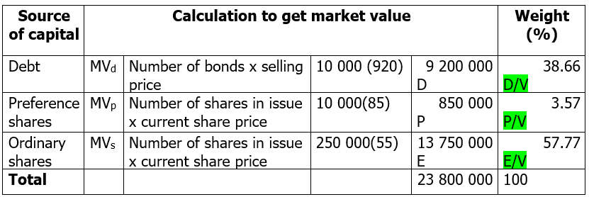
WACC example 1 (cont.)
Calculate the relevant market value capitalisation weights of debt, preference shares and ordinary shares

Slide 35
WACC example 1 (cont.)
Calculate the after-tax cost of debt, the cost of preference shares and the cost of ordinary shares. Show the relevant equations.
Before-tax cost of debt
PV = R920; FV = -1 000; PMT = -35 per semi-annum; n = 30 semi-annums; comp YTM = 3.96 x 2 = 7.92% p.a.
After-tax cost of debt
k_{i} = k_{d} (1 – t) = 7.92 (1 – 0.34) = 5.23%
Cost of preference shares
k_{p} = D/P₀ = R6/R85 = 7.06%
Cost of ordinary shares
k_{s} = R_{f} + ß x (k_{m} – R_{f})
= 0.05 + 1.4(0.07) = 14.80%

Slide 36
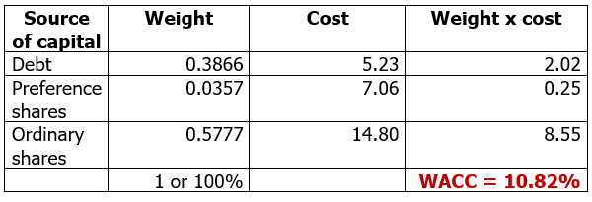
WACC example 1 (cont.)
Calculate the project’s weighted average cost of capital
WACC = [(D/V) x k_{i}] + [(P/V) x k_{p}] + [(E/V) x k_{n}]

Slide 37
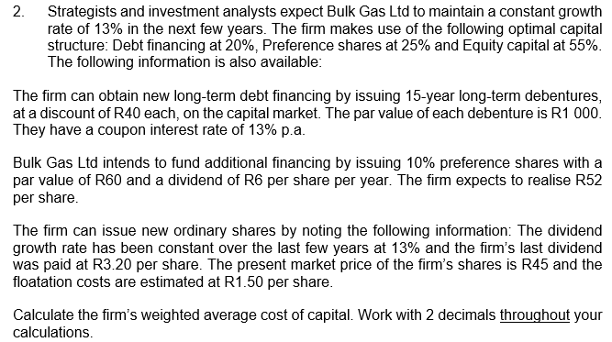
WACC example 2 – NB (SG pgs. 70 & 71)

Slide 38
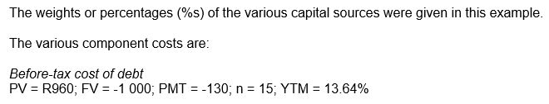


WACC example 2 (cont.)

Slide 39
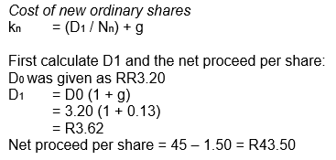

WACC example 2 (cont.)

Slide 40
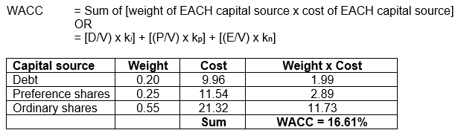
WACC example 2 (cont.)

Slide 41
WACC and IOS

Slide 42
Preparation for next session
Work through Chapter 15
Questions in study guide
Problems at the end of the chapter
As mentioned, this is the chapter with the highest mark allocation in the module…
Read through Chapter 16 and download/print the slides

